Slide 1
Pet Adoption
By: Gaby Castellanos
CSC 108 - MATH 080

Slide 2

The Pet Adoption Problem
Many shelters face overcrowding
Adoption times can vary widely
Understanding and recognizing patterns can improve adoption outcomes

Slide 3
…
What factors influence a pet’s likelihood of adoption?
What affects how long a pet stays in a shelter?

Slide 4
Dataset and Data Preparation
Pet Characteristics
PetType, Breed, AgeMonths, Size, WeightKg, Color
Health & Background
Vaccinated, HealthCondition, PreviousOwner
Outcome Variables
AdoptionLikelihood, TimeInShelterDays
Checked for missing values
Examined for potential outliers
Categorical variables encoded

Slide 5
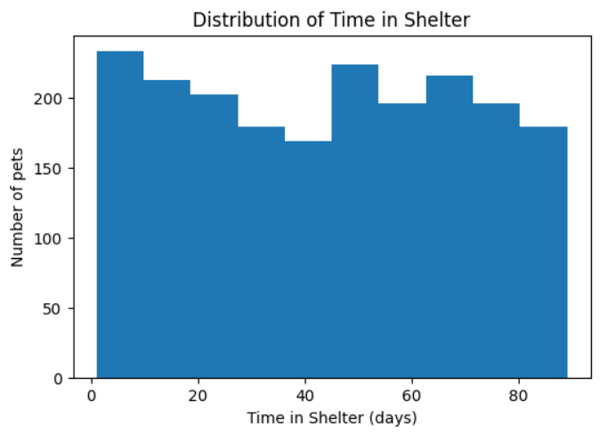
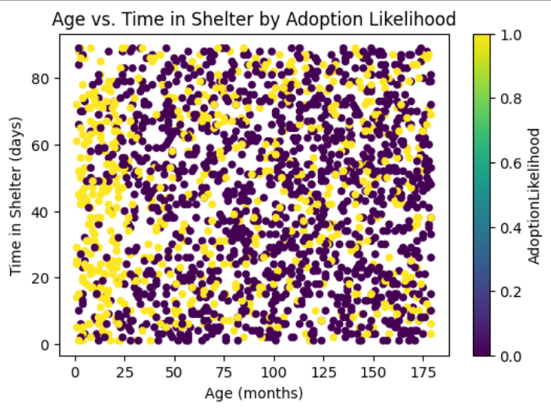
Initial Data Exploration and Analysis

Slide 6
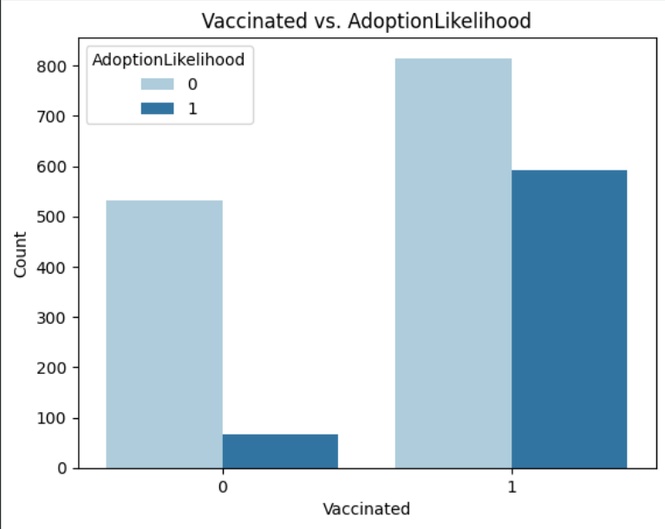
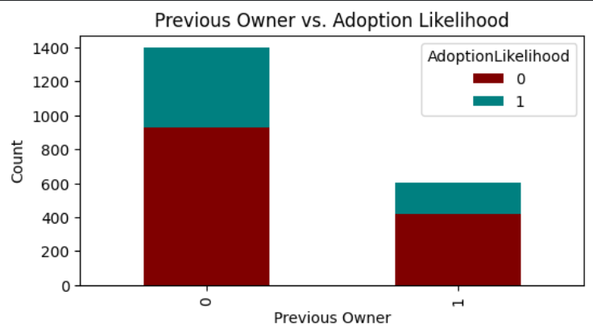
Additional Important Relationships

Slide 7
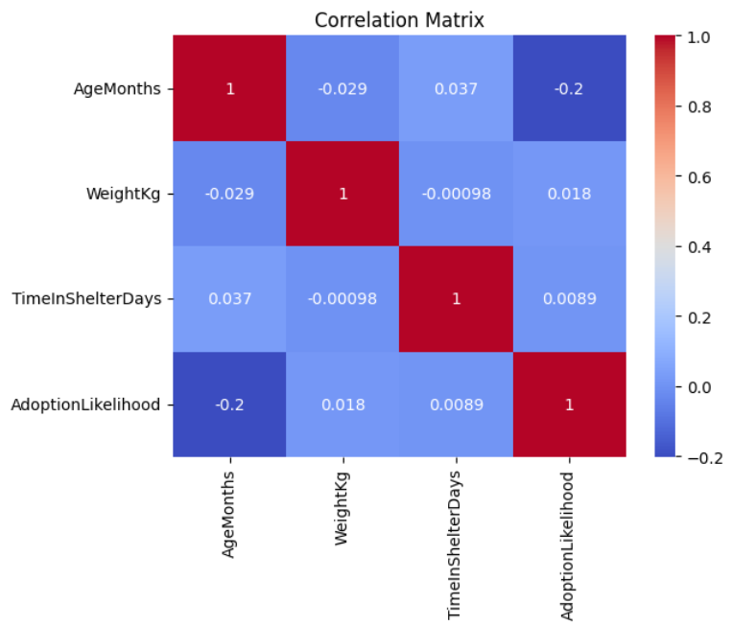
Correlation Matrix

Slide 8
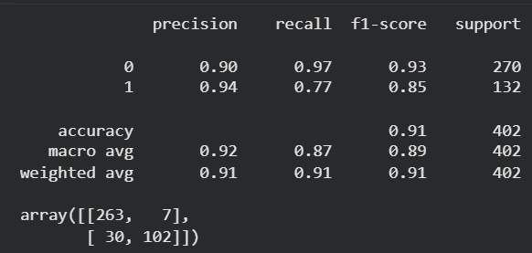
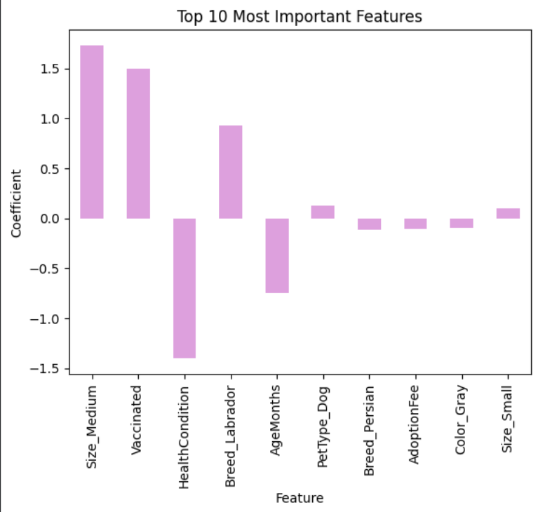
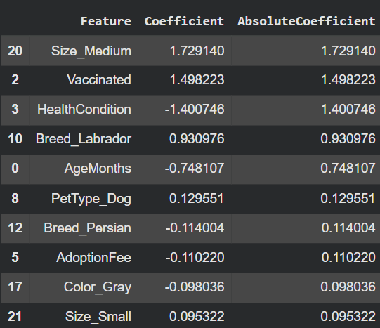
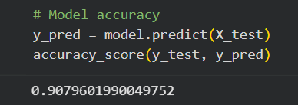
Logistic Regression Model

Slide 9
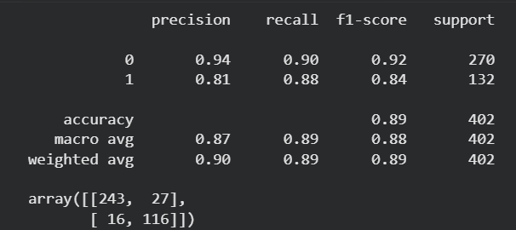
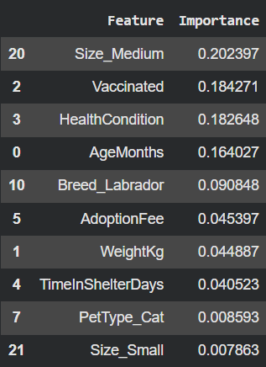
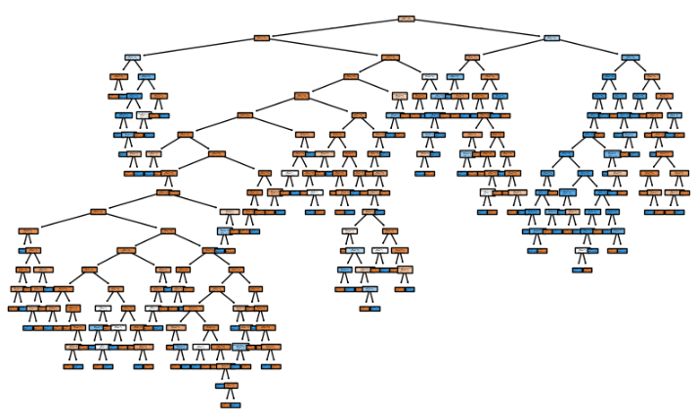
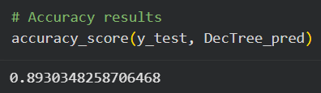
Decision Tree Model

Slide 10
Model Comparison
 | Logistic Regression | Decision Tree
Accuracy | 91% | 89%
Precision | Higher overall | Slightly lower
Recall for Adopted Pets | Lower | Higher
Strength | Balanced predictions | Better at identifying adopted pets
Weakness | Missed some adopted pets | More false positives

Slide 11
Conclusion and Future Work
Most influential factors: vaccination status, health condition, size…
Influential traits should be focused on
Future work: more models, outside variables, larger datasets

